Slide 1
SOURCE WATER MONITORING
ENGINEER 2PX3 Team: : Water-48
Prepared by: Antheus Aldridge, Darshini Coore, Yasmine El Khouly, Wenrui He, Syed Ali Zaidi

Slide 2
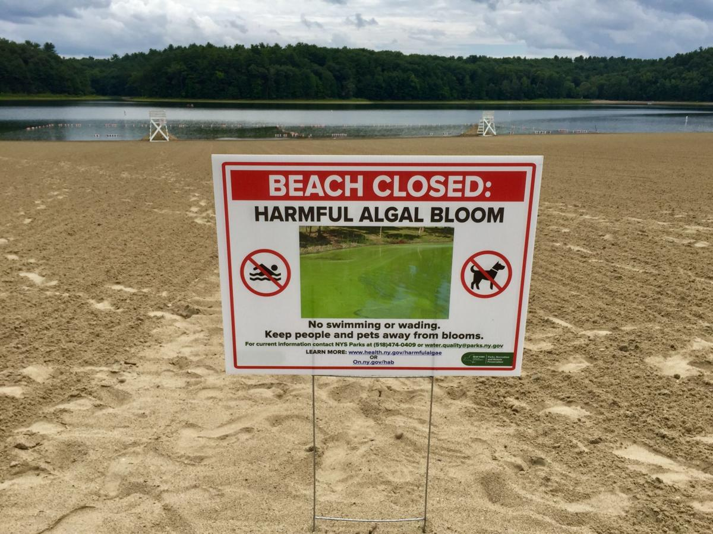
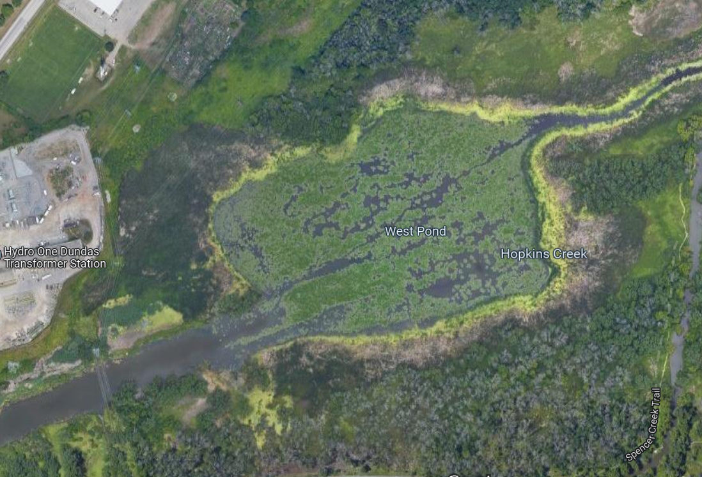
Introduction
Climate change → more algal blooms
Cyanobacteria release cyanotoxins
Important to detect blooms early

Slide 3
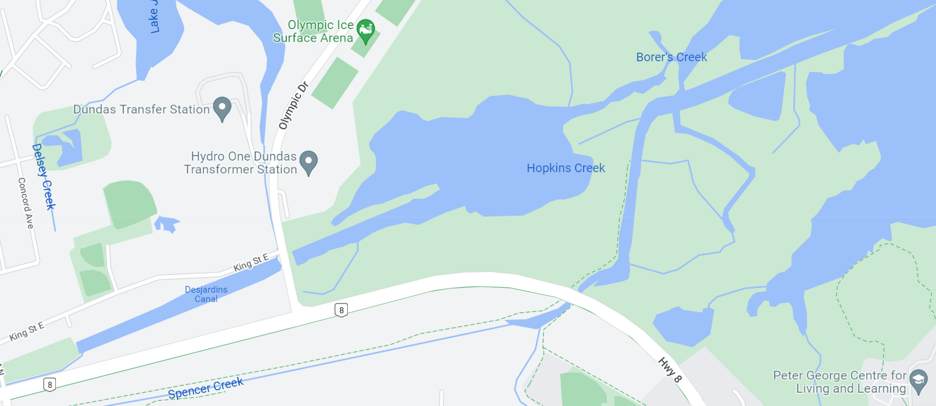
Solution Parameters
Focus on the Hamilton-Halton region of Lake Ontario
Our solution should:
Alert water treatment facilities when a bloom is detected
Have a minimal impact on environment
Small socio-cultural impact
Comply with local and Federal regulations

Slide 4
Stakeholders
Stakeholders relate to constraints and parameters of our solution
Primary:
Water treatment plants → performance constraints
Wildlife and environmental activists → environmental constraints
Nearby citizens → socio-cultural and performance constraints
Secondary:
Tourism Industry
Fishing Industry
Drone Manufacturers
Media Corporations

Slide 5
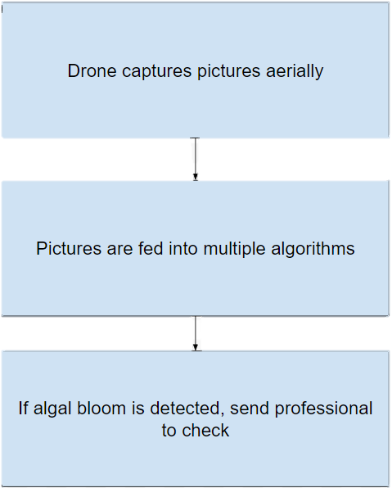
Our solution
Use a drone to aerially monitor the lake and capture pictures
Pictures go through multiple algorithms to detect algal blooms
If there is a detection, alert water treatment facilities who send out a professional

Slide 6
PERSEID Framework

Slide 7
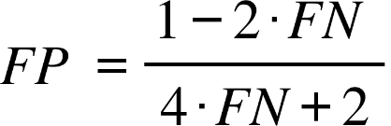
Performance Constraints
Acquires large number of high resolution images
Rechargeable battery and accessible charging station
Low battery consumption
Withstand severe weather conditions
Need to avoid false negatives
Selected FN = 5% = 0.05
Notes:
300-400 images
Need to analyze the number of pixels
Using a charging pad for autonomous charging
Using a wet suit
False positives vs false negatives:
FP = algorithm says algae present when no algae present
FN = algorithm fails to detect algae present in lake
Consequences of FN more dangerous/dire than those of FP
Therefore we have constrained our algorithm to have a low rate of FN (5%)
We were given the equation (shown on slide) relating false positives and false negatives, so we set FN = 0.05 and calculated the corresponding FP rate to be 40%

Slide 8
Environmental Constraints
Noise Pollution
Speed limit set when flying over environmentally sensitive areas
Protects safety of wildlife in instance of collision
Avoids flying and gliding animals
Notes:
Drone autonomous then there is a risk of crashing
20 m/s
- Blooms most commonly occur in late summer and early fall and the drone will operate in such weather conditions.
- Rain, misting, or heavy fog forms condensation on the camera, which impacts image quality.

Slide 9
Regulatory Constraints
Fly within the height limit
Must not break any privacy law
Away from emergency operations and advertised events
Away from airports and heliports
Far away from other aircraft
Survey the area where drone will be flown
Notes:
122 meters
(at least 5.6 km) and (at least 1.9 km)
Survey for buildings and powerlines and other obstacles

Slide 10
Socio-Cultural Constraints
Flies away from bystanders and residential areas
Privacy and Data Protection
Community Surveying and Acceptance
Protects Safety of People in instance of collision
Notes:
At a minimum horizontal distance of 30 meters to avoid noise and privacy concerns
Risk of getting information leaked from SIM

Slide 11
Conflicting Points raised by PERSEID

Slide 12
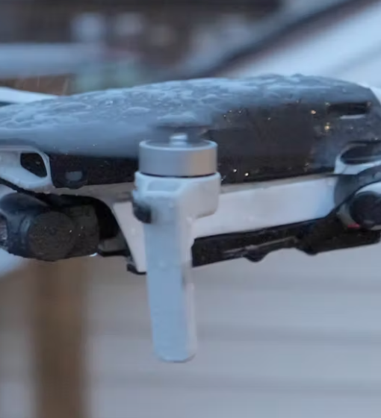
Conflicting Design Choices (Drone)
Pulsing Light on the Drone (Avoid Bird Collision) vs. Maneuverability
Cage (Avoid Drone Accident) vs. Speed, Maneuverability, Battery life
Noise Pollution (Silent propellers, Brushless motor, and Noise reduction shrouds and Sand Down the Surface of the Propellers) vs. Speed, Maneuverability, Durability
Wet Suit vs. Speed, Maneuverability, Battery life
Weather vs. Speed, Maneuverability

Slide 13
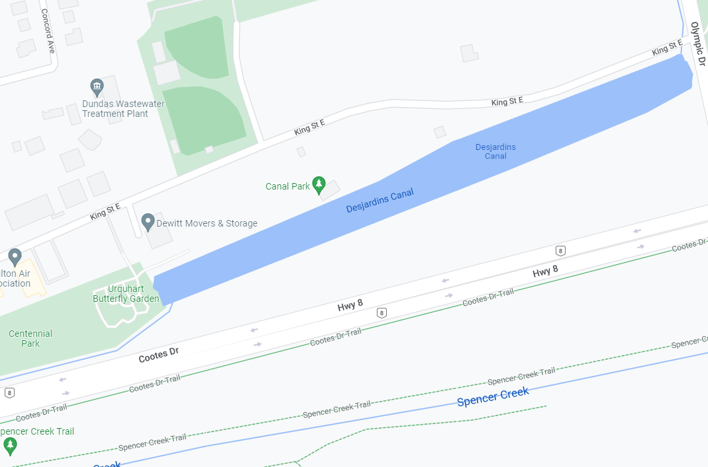
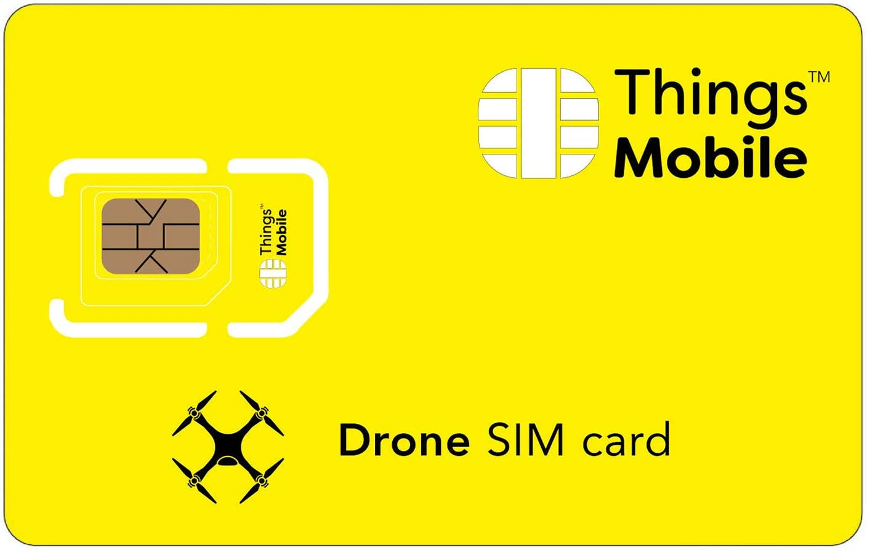
Conflicting Design Choices (Operations and Algorithm)
Number of Images vs. Storage Capacity/Security (SIM/ SD card)
Number of Images vs. Privacy Concern
Number of Images vs. Battery Life
Number of Images/Image Resolution vs. Accuracy, processing time
Weather vs. Image Resolution
Speed vs. Image Resolution
Flight Path/Height vs. Privacy Concern
Flight Path vs. Battery Life

Slide 14
Design Choices and Decisions

Slide 15
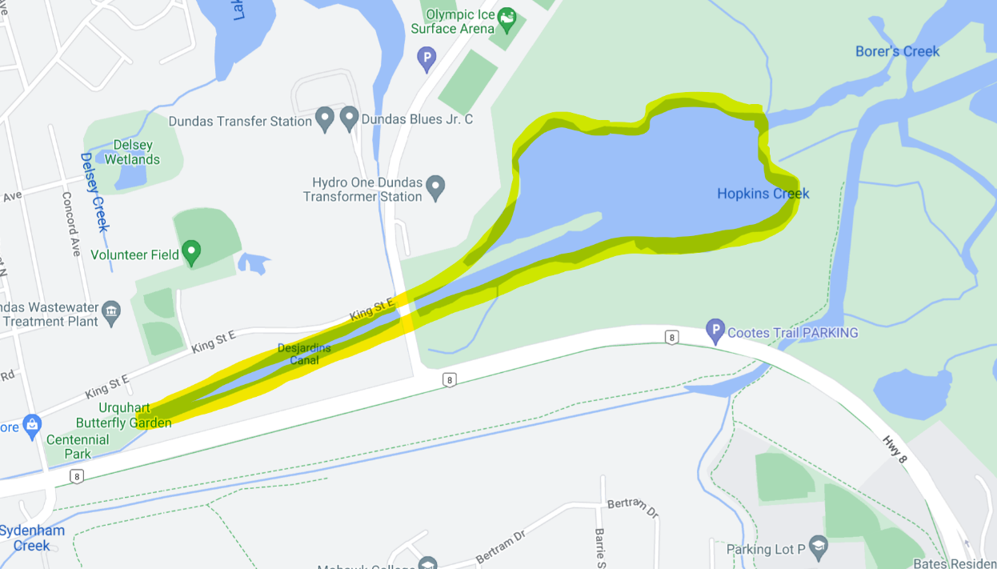
Design 1

Slide 16
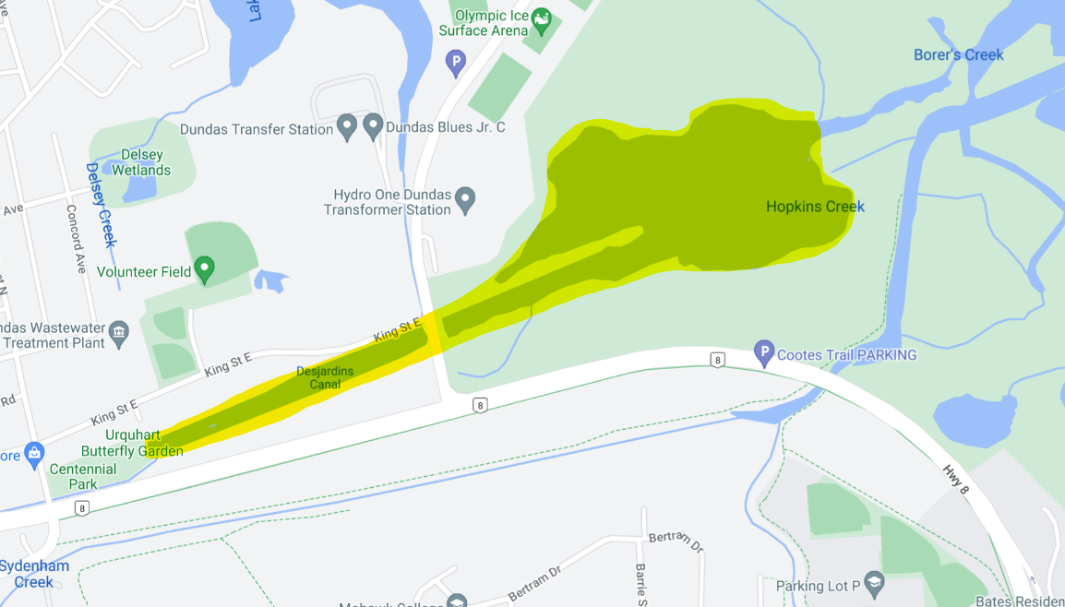
Design 2

Slide 17
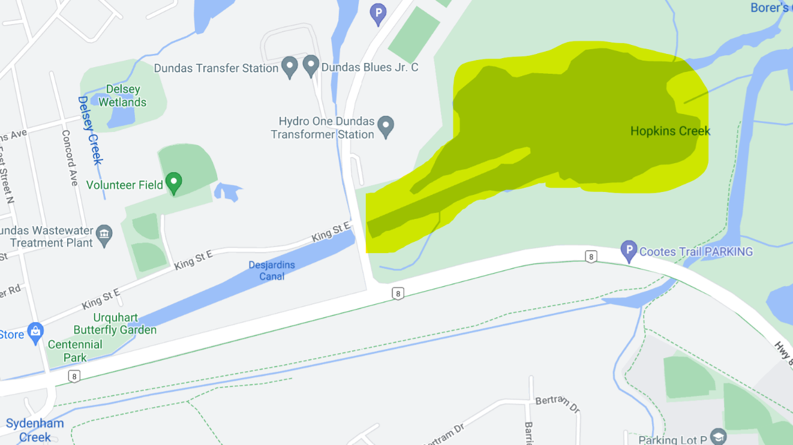
Design 3

Slide 18
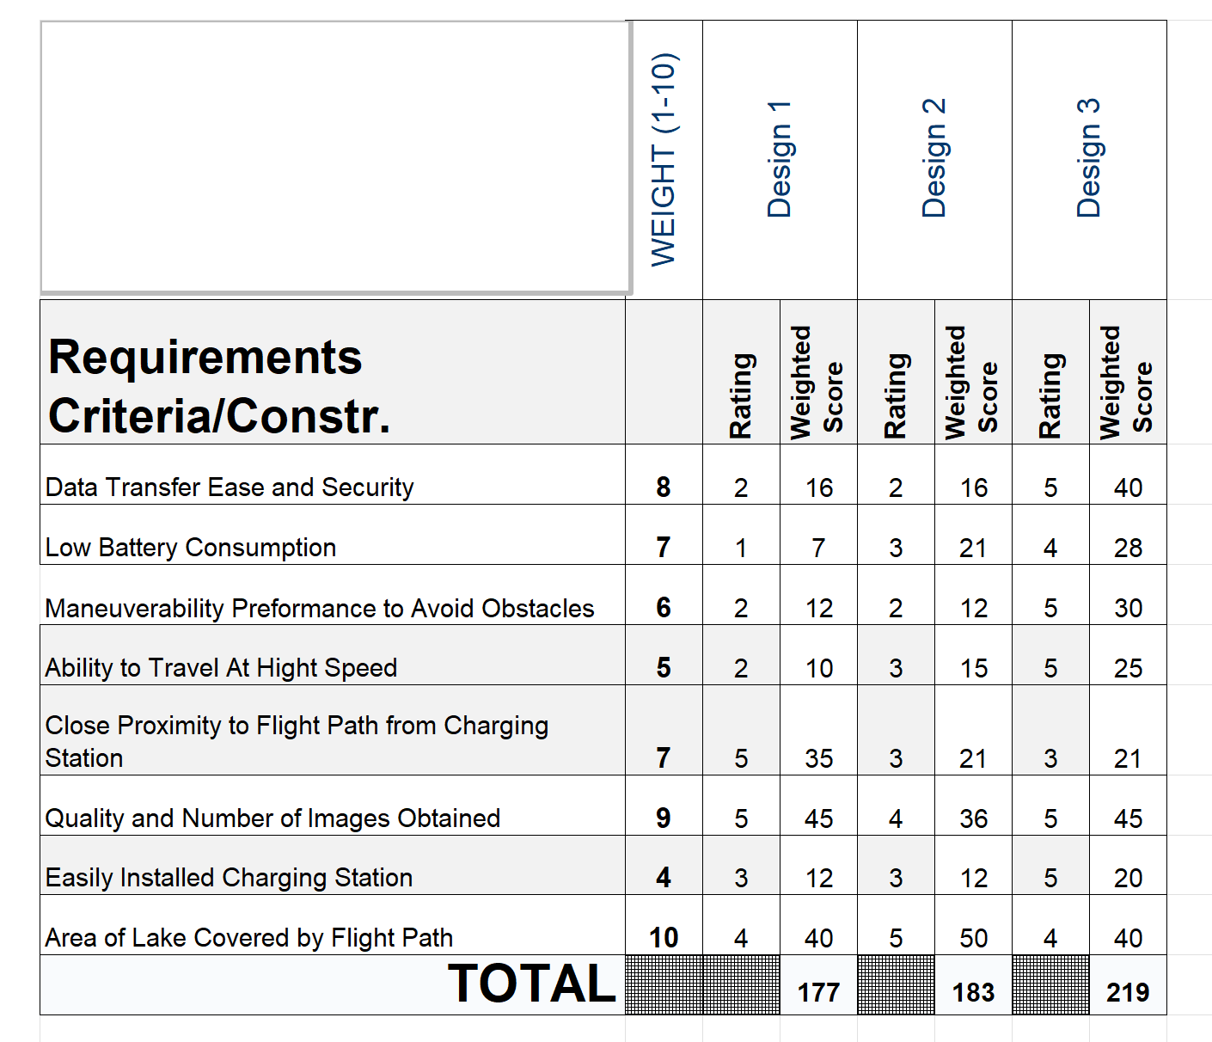
Technical Decision Matrix
Design 3 Ranks Highest

Slide 19
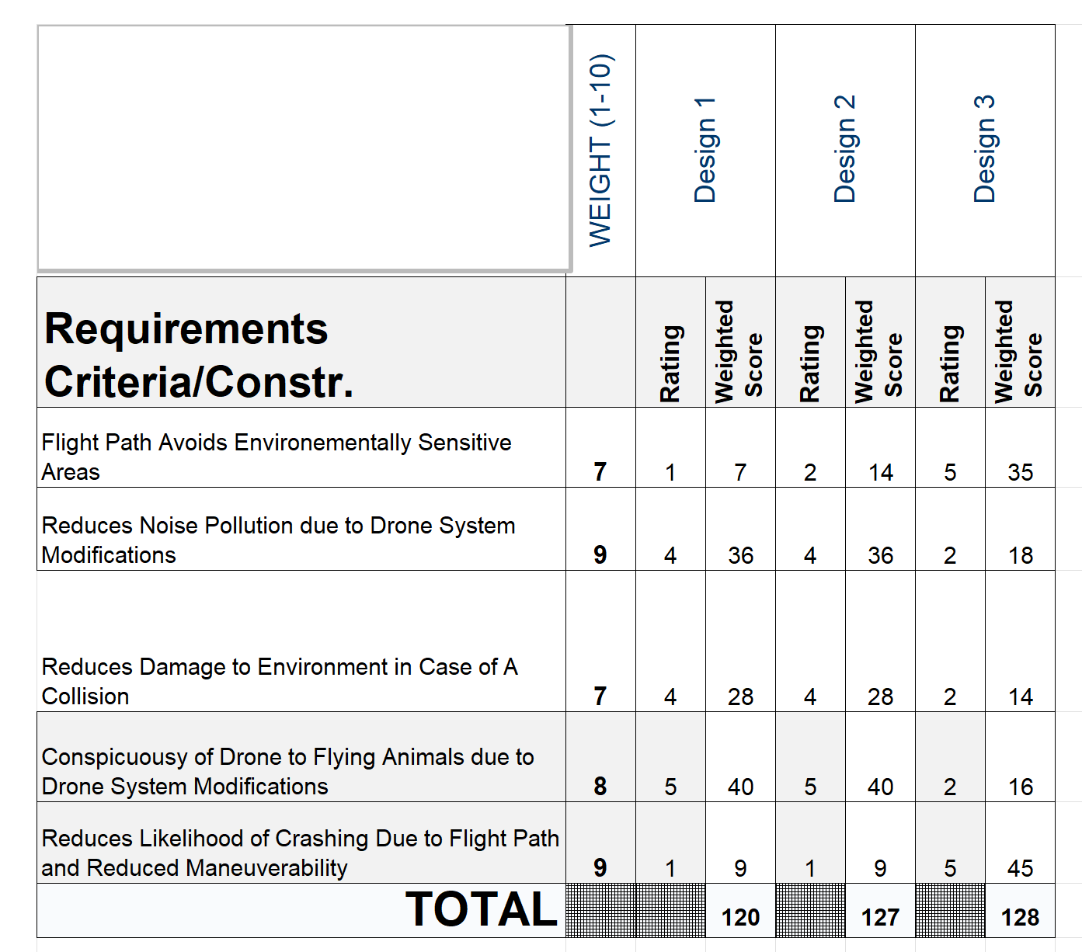
Environmental Performance
Design 3 Ranks Highest

Slide 20
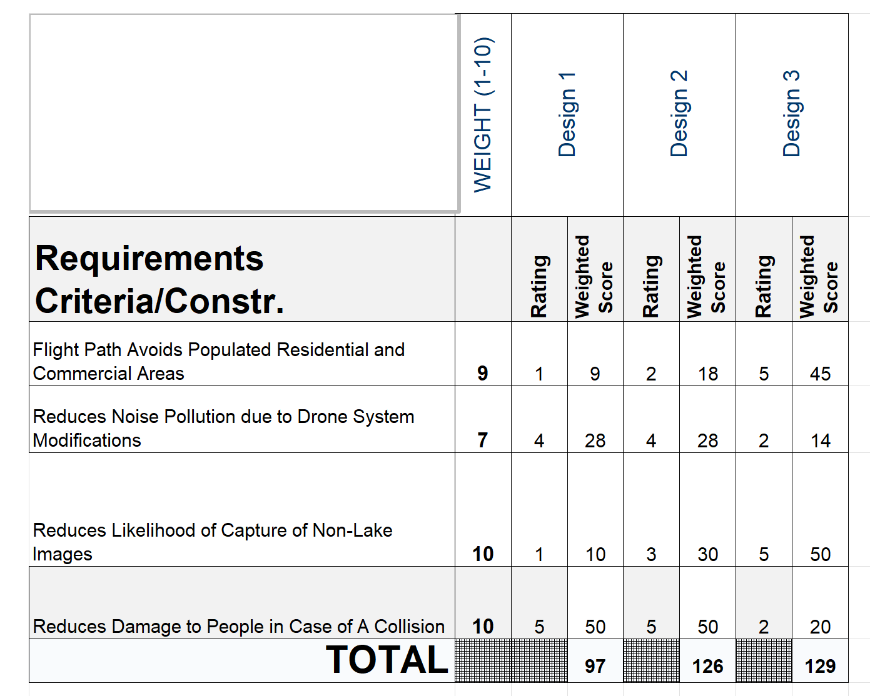
Socio-Cultural Performance
Design 3 Ranks Highest

Slide 21
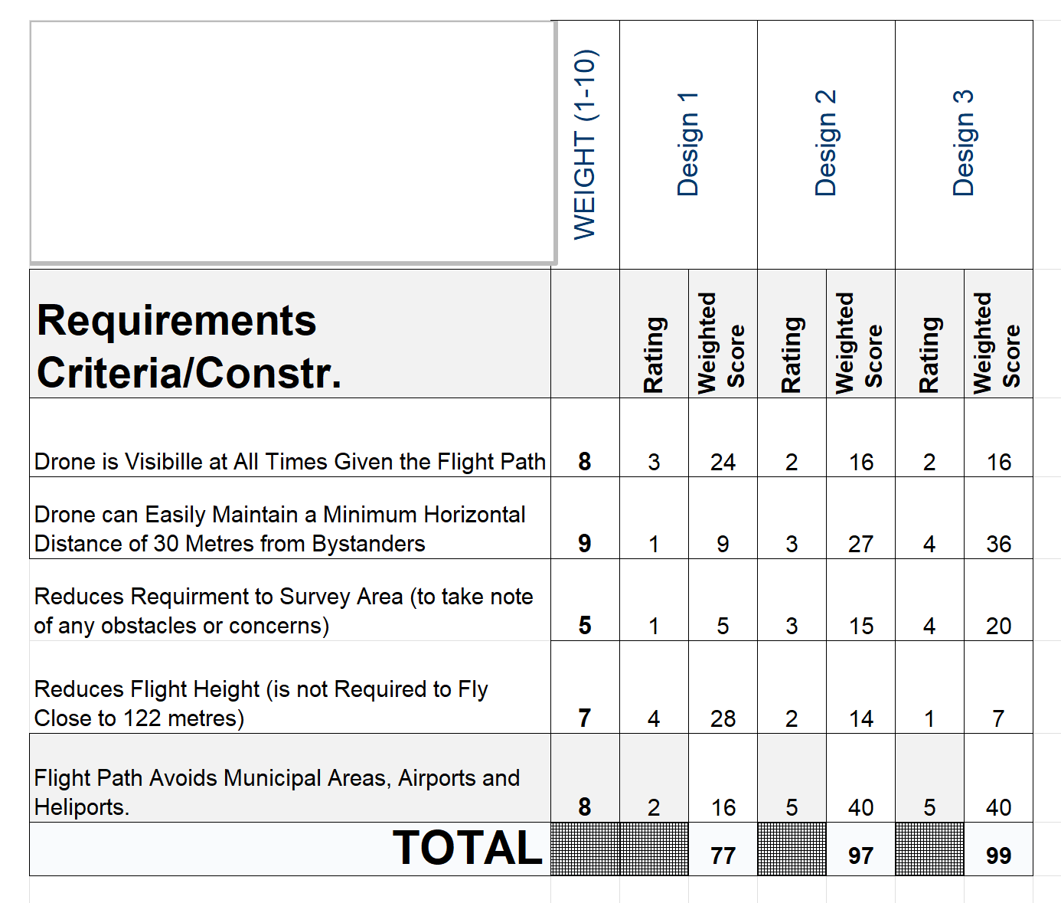
Regulatory Performance
Design 3 Ranks Highest

Slide 22
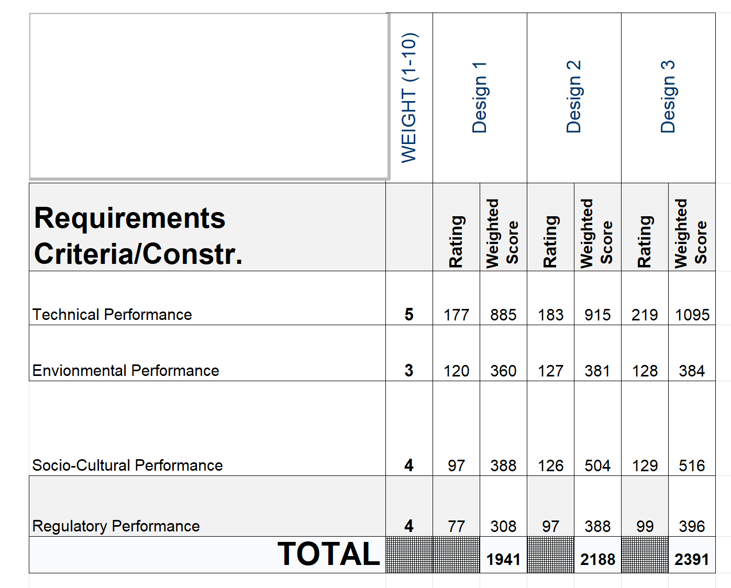
Overall Performance
Design 3 Ranks Highest Overall

Slide 23
Model Validation
Testing and Evaluating the Algorithm

Slide 24
Inputs
Number of iterations
Number of images
Image resolution

Slide 25

Quality Checks
Loss
Testing/Validation
Training
Accuracy
Testing/Validation
Training

Slide 26
Results

Slide 27
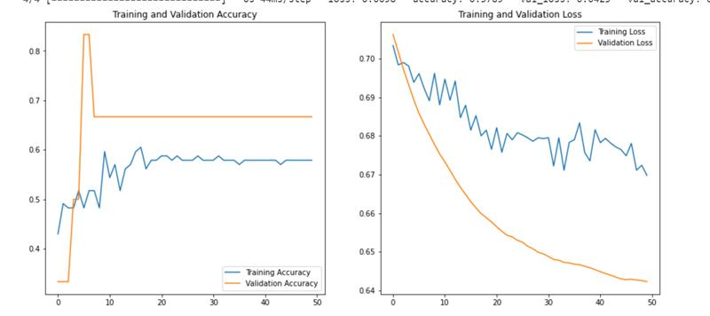
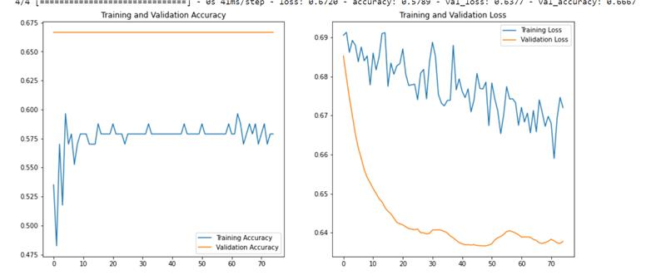
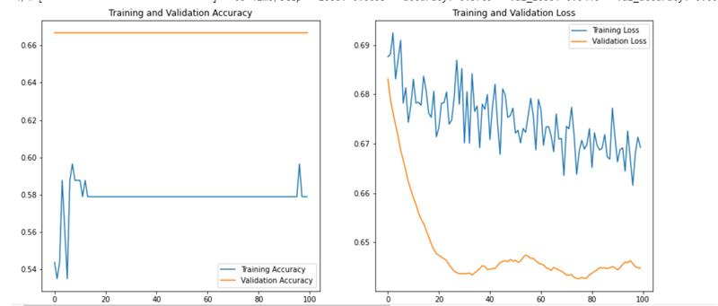
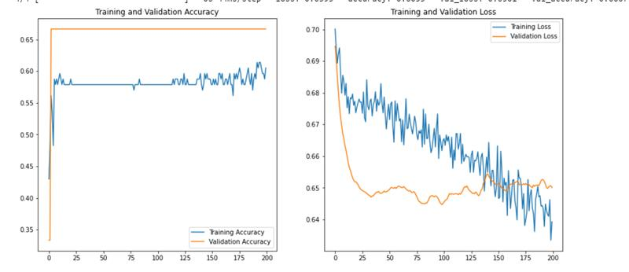
Number of Iterations – Training vs Validation Loss
50 Iterations
75 Iterations
100 Iterations
200 Iterations
Increased iterations → Decreased loss
Notes:
Maybe we can follow this slide with a series of graphs showing how varying each input affected the loss and characterize the loss as under/over/good fit (same for accuracy slide)?

Slide 28
Number of Iterations – Training vs Validation Accuracy
50 iterations
75 iterations
100 iterations
200 iterations
Increased iterations → Increased accuracy
Notes:
Maybe we can follow this slide with a series of graphs showing how varying each input affected the loss and characterize the loss as under/over/good fit (same for accuracy slide)?

Slide 29
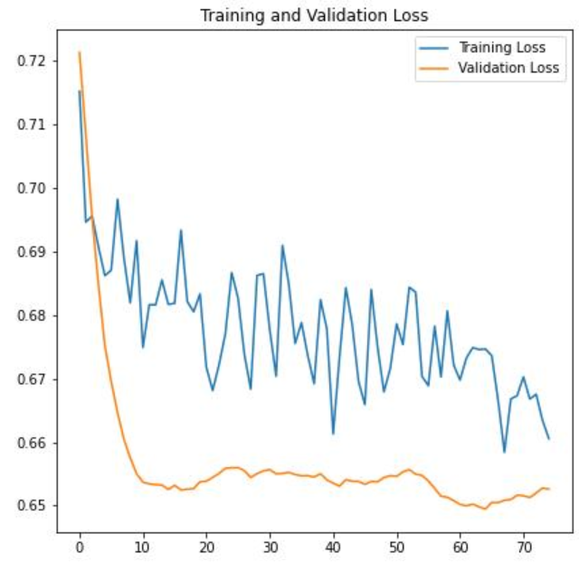
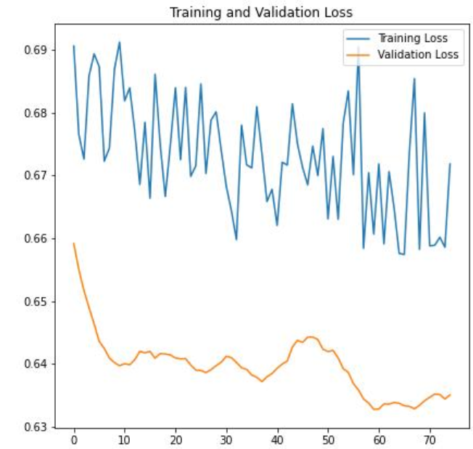
Number of Images – Training vs Validation Loss
Original
Decreased Images
Fewer images → Higher loss

Slide 30
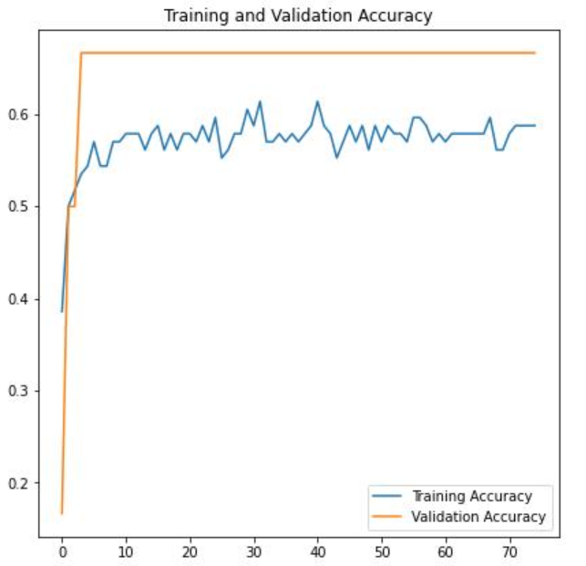
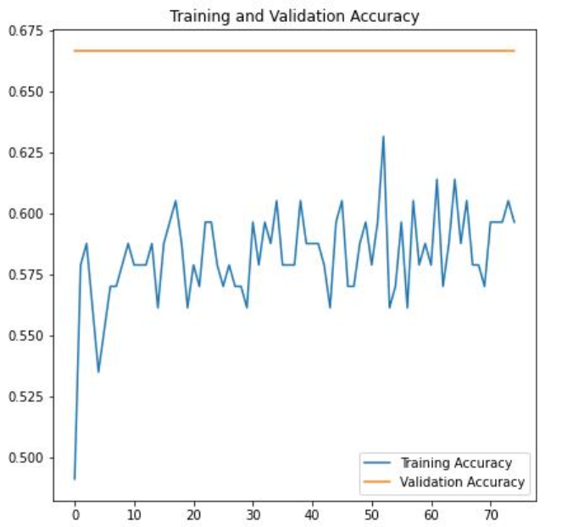
Number of Images – Training vs Validation Accuracy
Original
Decreased Images
Fewer images → Lower accuracy

Slide 31
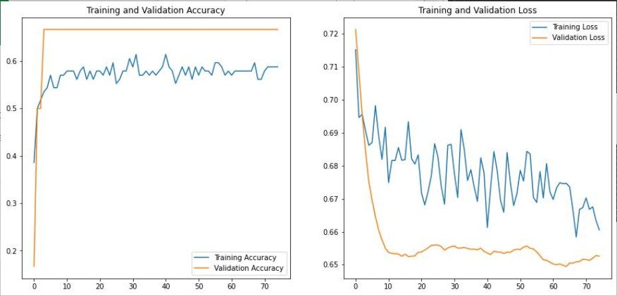
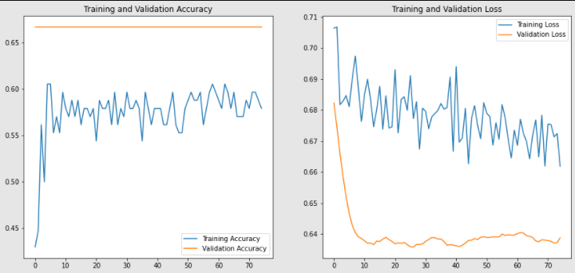
Image Resolution – Training vs Validation Loss
Original
Increased Resolution
Higher Resolution → Lower loss

Slide 32
Image Resolution – Training vs Validation Accuracy
Original
Increased Resolution
Higher Resolution → Higher accuracy

Slide 33
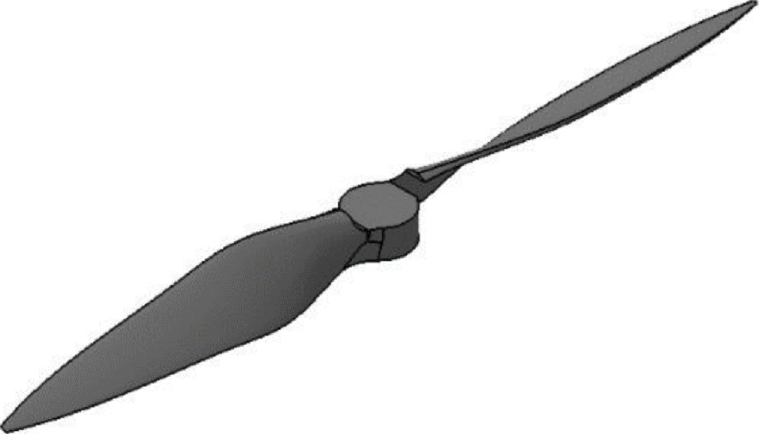
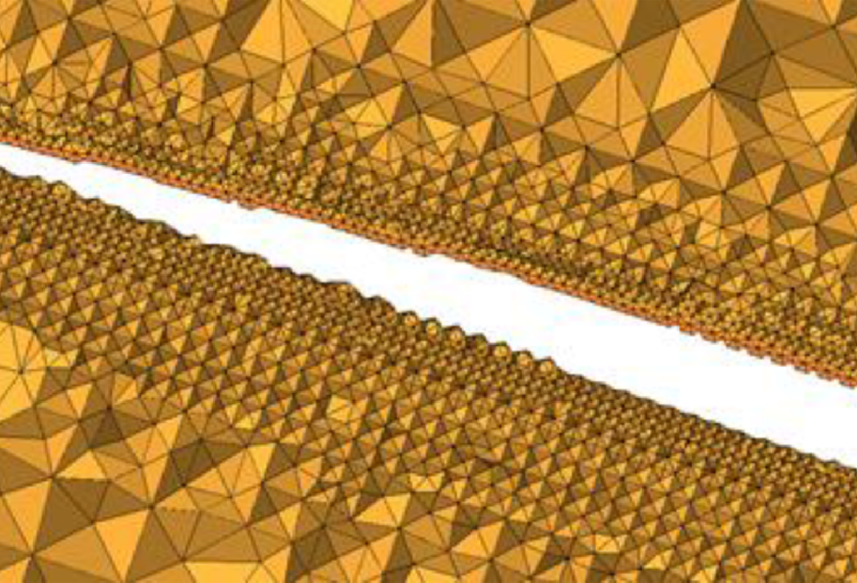
Final Design
Design 2 + Design 3 + …
Bright coloured drone
Blinking light
Silent propellers (sanding)
Brushless motors
Noise reduction shrouds around propellers
Compliant mesh cage
Survey of communities in surrounding area

Slide 34
References
[1] “Project Module - Source Water Monitoring - ENGINEER 2PX3: Integrated Engineering Design Project 2.” https://avenue.cllmcmaster.ca/d2l/le/content/430517/viewContent/3560652/View?ou=430517 (accessed Feb. 05, 2022).
[2] “Phantom 4 Pro V2.0 - Specifications - DJI.” https://www.dji.com/ca/phantom-4-pro-v2/specs (accessed Feb. 04, 2022).
[3] “Ready for Take-Off? Integrating Drones into the Transport System”, Accessed: Mar. 12, 2022. [Online]. Available: www.itf-oecd.org
[4] “Canadian Aviation Regulations (SOR/96-433).” https://tc.canada.ca/en/corporate-services/acts-regulations/list-regulations/canadian-aviation-regulations-sor-96-433 (accessed Mar. 12, 2022).
[5] “Drones in Canada - Office of the Privacy Commissioner of Canada.” https://www.priv.gc.ca/en/opc-actions-and-decisions/research/explore-privacy-research/2013/drones_201303/ (accessed Mar. 12, 2022).
[6] “Flying your drone safely and legally.” https://tc.canada.ca/en/aviation/drone-safety/learn-rules-you-fly-your-drone/flying-your-drone-safely-legally (accessed Mar. 12, 2022).

Slide 35
Questions?

